Slide 1
Bike showroom System
Milan Parmar - 240160510031

Slide 2
Existing System ProblemsShowrooms using manual or semi-digital systems face challenges like inventory mismatches, missed service appointments, and sales tracking issues.Lack of real-time updates causes delays in decision-making.
Customer service is often affected due to limited access to historical data or service records.There's no centralized system to manage bike models, customer interactions, servicing, and staff responsibilities efficiently.

Slide 3
New SystemThis system allows bike showroom staff to manage bikes,
customers, sales, and service records through a centralized digital platform.It provides real-time updates on inventory, customer interactions, and service requests.The system improves efficiency by automating tasks like billing, bike registration, and scheduling service appointments, helping streamline overall operations.
Need for a New SystemExisting manual or semi-automated systems do not provide real-time data or centralized control, leading to operational inefficiencies.There is a growing need for a digital solution that can manage bike inventory, monitor staff roles, handle customer data, and generate performance reports.Automating the system ensures faster processing, reduces human error, and enhances customer satisfaction.

Slide 4
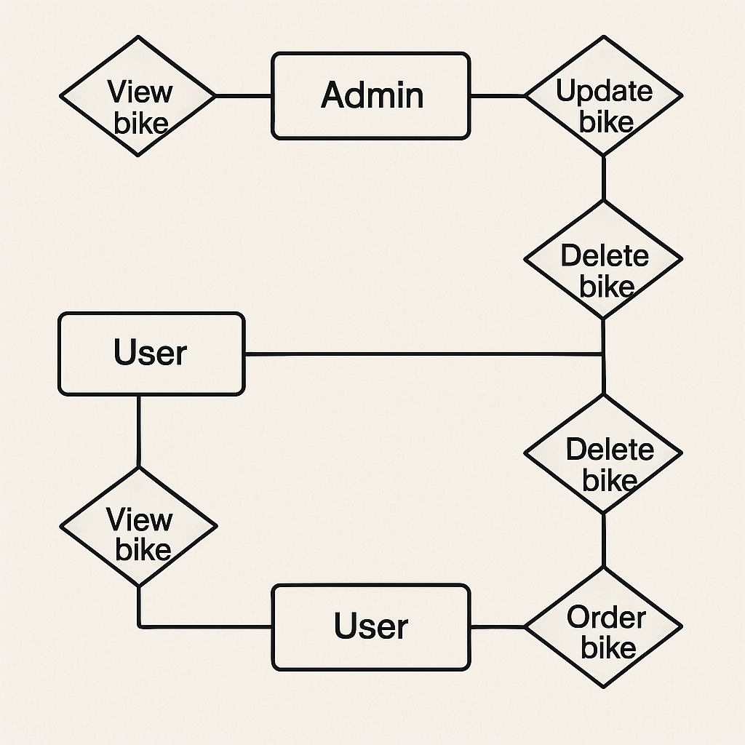
ER Diagram

Slide 5
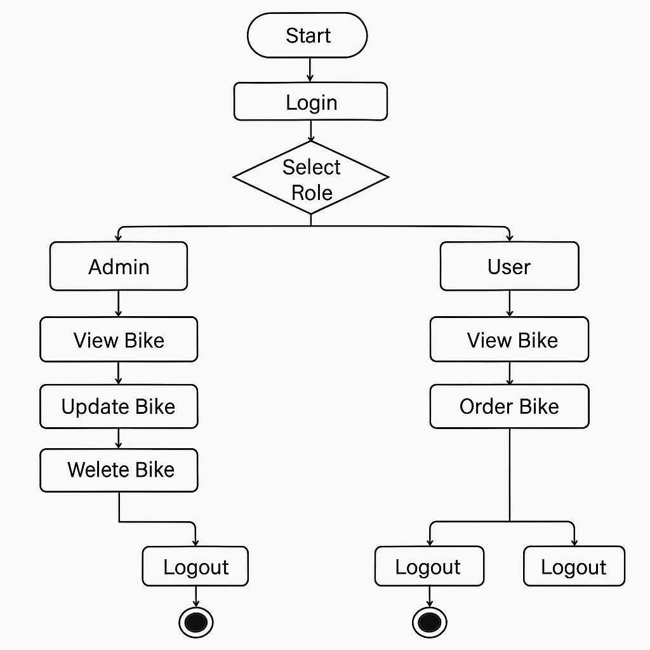
Activity Diagram :

Slide 6
Admin:
:- The page require user name and password to start the application.
:- Login is a process by which individual access to a computer system is
controlled by identifying and
authenticating the user through the cardinalities presented by the user.
:- Admin can delete the user.
:- Admin can add, update or delete the bike.
:- Admin can view the order of Bike.

Slide 7
user:
:- user can register the account by fill the information about you and click on save button.
:- The user have to login to get more information about the Bike
:- The customer can buy the Bike, view the Bike

Slide 8
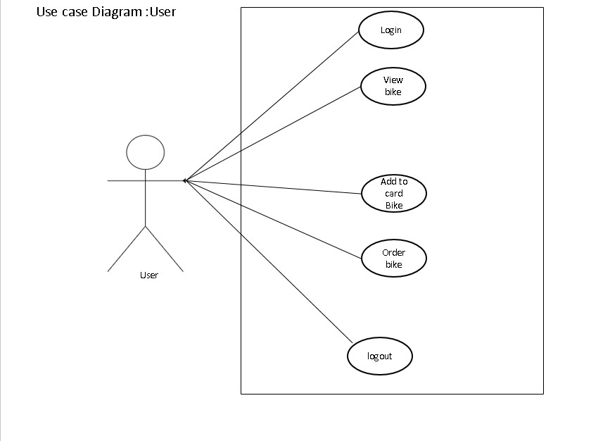

Slide 9
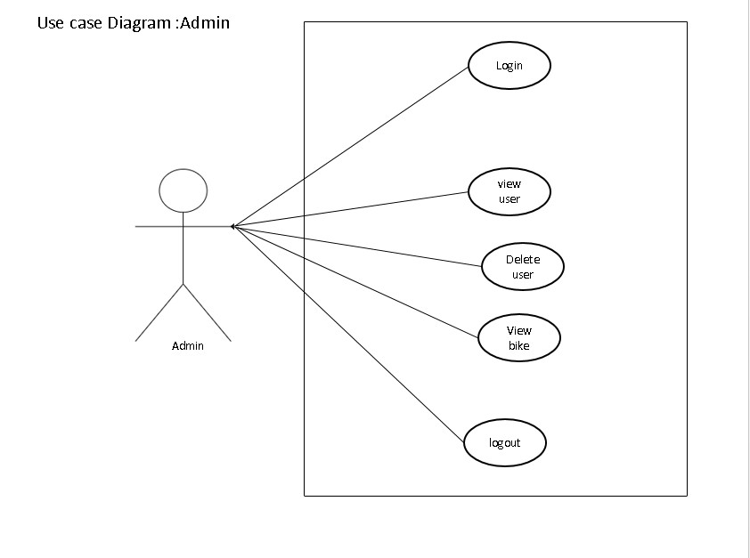

Slide 10
Data Dictionary :
Admin : (AdminID ,Username,Password,Image)
User: ( UserID,Username,Password,Email,MobileNo,Gender,Role,image)
Bike: (BikeID,BikeName,Image,price)

Slide 11
Thank you…

